Slide 1

UNIFIED MENTOR INTERNSHIP
Project -3 : Supply Chain Management Dashboard Analysis
Name - SHASHANK BAJPAI
Email – Shashankax0@gmail.com
Designation – Business Analyst Intern

Slide 2

Project summary
To design a data-driven dashboard that analyzes and visualizes key supply chain operations — including sales, inventory, supplier performance, shipping costs, and customer behavior — for a Fashion & Beauty company.
📊 Key Areas Covered:
Product & location-wise revenue and sales
Inventory availability across product types
Supplier lead time and delivery performance
Transportation cost by mode & city
Customer demographics and buying trends
✅ Outcome:
* Identified Skincare as the top-selling product
Flagged high shipping costs via Road & Air
Supplier 3 & 5 found to have highest delivery delays
Revealed Kolkata & Chennai as high-demand regions

Slide 3

📊 Dataset Description
📁 Data Includes:
* Product Details:
Product Type (Skincare, Haircare, Cosmetics)
Units Sold, Revenue, Availability, Inventory
* Customer Demographics:
Gender
Location (Cities: Delhi, Kolkata, Mumbai, etc.)
* Supplier & Manufacturing Info:
Supplier Name
Lead Time
Manufacturing Cost
Defect Rate
* Transportation & Logistics:
Shipping Mode (Air, Road, Rail, Sea)
Shipping Cost by City
Transportation Route Performance

Slide 4

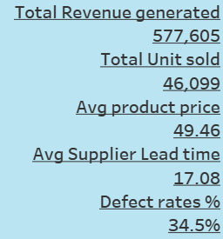
📊 KPIs Tracked:
KPI | Value | Insight
Total Revenue Generated | ₹577,605 | Indicates strong product-market traction, primarily driven by skincare
Total Units Sold | 46,099 units | High sales volume supports inventory movement and production efficiency
Average Product Price | ₹49.46 | Shows moderate pricing; skincare contributes highest to revenue
Avg. Supplier Lead Time | 17.08 days | Acceptable range, but some suppliers exceed 22 days
Defect Rate | 34.5% | High defect rate highlights need for supplier quality improvement

Slide 5
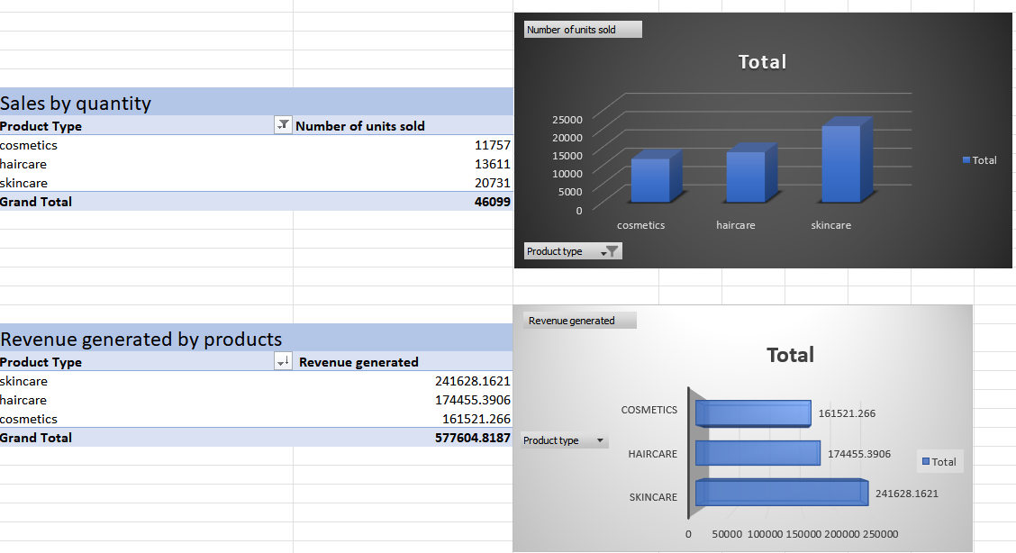

Slide 6
📦 Sales & Revenue by Product Type
📊 Insight:
Skincare leads in both revenue (₹2.41L) and units sold (20,731
Haircare performs moderately: ₹1.74L from 13,611 units
Cosmetics is the lowest: ₹1.61L from 11,757 units
🔹 Skincare contributes the largest share to both revenue and volume.
✅ Suggestions for Growth:
Scale skincare production to meet high demand
Revamp cosmetics with offers or bundling to boost sales
Promote haircare in new regions to tap untapped demand

Slide 7
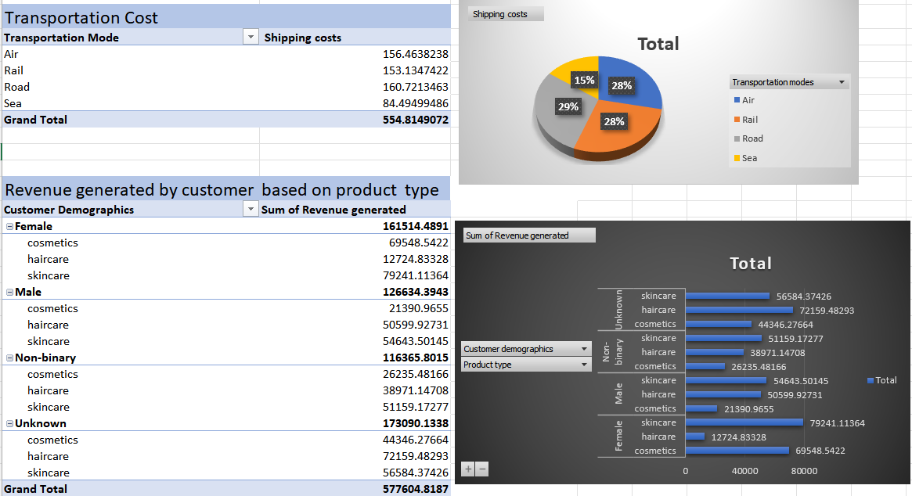

Slide 8
🚚👥 Transportation & Customer Insight
📊 Insight:
Road and Air transport account for ~57% of total shipping cost, making them the most expensive modes
Sea transport, despite being the cheapest, is underused
Female customers drive the highest revenue, especially in skincare
Non-binary and unknown demographics also show strong revenue potential
✅ Suggestions for Growth:
Optimize logistics by shifting bulk shipments to Sea or Rail to reduce costs
Target female customers with skincare bundles and promotions
Leverage inclusive marketing to further engage non-binary and unknown segments

Slide 9
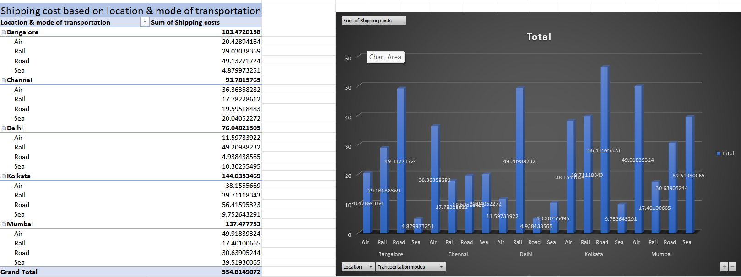

Slide 10
📍 Shipping Cost by Location & mode of transportation
📊 Insight:
Kolkata (₹144K) and Mumbai (₹137K) together contribute nearly half of the total shipping cost, indicating these cities are the most logistics-intensive hubs.
In these locations, Air and Road transport dominate, significantly driving up total cost.
Chennai (₹113K) follows, but shows a more balanced mode usage compared to Kolkata.
Delhi (₹76K) has the lowest shipping cost among major locations, indicating efficient mode utilization or better supplier proximity.
Across all cities, Sea and Rail remain underutilized, despite their lower cost profile — this reflects a possible operational preference for faster but costlier modes.
The concentration of high costs in a few locations suggests a regional imbalance in distribution or demand load.
✅ Suggestions for Growth:
Review logistics partners and negotiate better rates in high-cost zones like Kolkata and Mumbai
Shift non-urgent deliveries to Sea or Rail where applicable
Implement route optimization tools to reduce over-reliance on costly transport modes

Slide 11
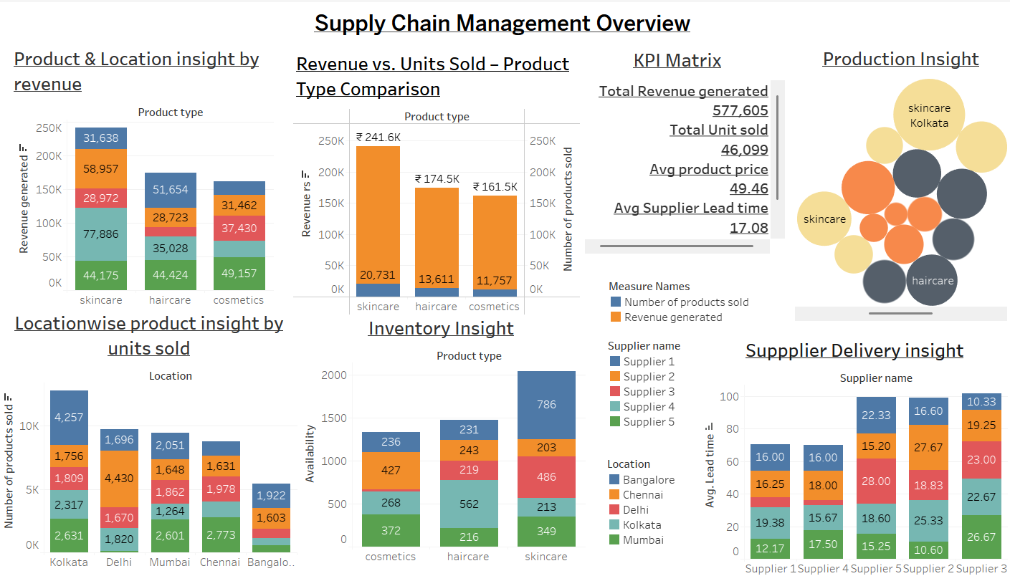

Slide 12
📊 Tableau Dashboard – Key Insights
Product-Location Synergy
* Skincare generates the highest revenue across all major cities, especially in Kolkata and Chennai, where unit sales and availability are well-aligned.
* Cosmetics, despite good availability in Bangalore and Chennai, show lower sales, hinting at a demand-supply mismatch in those regions.
🔹 2. Inventory Allocation Gaps
* Haircare inventory is relatively balanced across cities, but sales are not equally distributed, with lower movement in Chennai and Mumbai.
* Cosmetics inventory in Delhi is relatively high compared to actual sales volume, suggesting potential overstocking or low regional demand.
🔹 3. Supplier Lead Time Imbalance
* While the average supplier lead time is 17.08 days, some cities (e.g., Chennai via Supplier 2 and 5) consistently show higher delivery delays (22–27 days).
* Supplier 3 performs best in Kolkata and Mumbai, delivering in under 12 days — possibly ideal for high-demand zones.
.

Slide 13
🚀 Suggestions for Growth
🔧 1. Optimize Product Placement by Region
Reallocate cosmetics inventory from low-performing regions (e.g., Bangalore, Chennai) to more promising markets or reduce stock to minimize holding cost.
🧠 2. Target Skincare in High-ROI Locations
Continue boosting skincare in Kolkata and Chennai, which show the best combination of revenue, sales volume, and stock readiness.
⏱️ 3. Streamline High-Delay Suppliers
Focus on reducing lead times for Supplier 2 and 5, especially in cities where demand is high and delays are significant.
💡 4. Create City-Specific Product Bundles
For example, introduce Haircare + Skincare bundles in cities like Delhi and Mumbai, where both products perform well but may need value-driven marketing.
🛒 5. Introduce Dynamic Replenishment
Automate restocking using inventory vs. sales ratios to prevent overstock (e.g., cosmetics in Bangalore) and stockouts (e.g., skincare in Kolkata).

Slide 14
Conclusion
📘 Content:
The dashboard successfully provided a 360° analysis of the supply chain — covering products, geography, customer behavior, suppliers, inventory, and logistics
Skincare proved to be the highest-value product line, contributing the most in terms of both revenue and volume
Kolkata emerged as a strategic city, leading in both production and sales, but also incurring the highest shipping cost
Cosmetics showed the lowest performance, despite comparable inventory levels — revealing inefficiencies in inventory
placement and low regional demand
The Inventory Insight exposed imbalanced stock allocation, especially where low-selling products had high availability (e.g., cosmetics in Bangalore)
Customer Demographic Analysis highlighted female buyers as key contributors, especially in skincare, and untapped potential in non-binary and unknown segments
Transportation Cost Analysis revealed over-dependence on Road and Air, which together accounted for over 55% of logistics cost, while Sea was least used despite being cheapest
Supplier Delivery Insight showed significant variation in lead times, with Supplier 3 performing best, and Suppliers 2 and 5 causing delays in high-demand cities

Slide 15

Thank you for the opportunity.
Open to questions or further analysis.

